Slide 1

Bankruptcy Prediction
Team: Maverick Miners

Slide 2
Overview
Dataset
10,000 data, middle large dataset
64 predictor variables
Activity Ratio
Liquidity Ratio
Solvency Ratios
Profitability Ratios
Valuation Ratios
Target Variables
‘Class’ is a binary categorical variable
0 as do not bankrupt, 1 as bankrupt
Predictor Variables
Mostly are financial formulas and ratios
No categorical variables
Can be divided by five categories based on CFA Institutes’ Standard
Overview
Exploratory Data Analysis
Data Preprocessing
Variable Selection
Model Selection
Thoughts
Notes:
1. Activity Ratios
These measure how efficiently a company uses its assets.
Total Asset Turnover Ratio (attr9, attr36)
Inventory Turnover Ratio (attr60)
Inventory Turnover in Days (attr20, attr47)
Receivables Turnover Ratio (attr61)
Days Sales Outstanding (DSO) (attr44)
Fixed Asset Turnover Ratio (attr64)
Cash Conversion Cycle (attr43)
Days Payable Outstanding (DPO) (attr32, attr52, attr62)
Short-term Liabilities Turnover Ratio (attr63)
2. Liquidity Ratios
These assess a company's ability to meet short-term obligations.Current Ratio (attr4)
Quick Ratio (attr46)
Cash Ratio (attr40)
Working Capital to Total Assets Ratio (attr3)
Working Capital to Fixed Assets Ratio (attr28)
3. Solvency Ratios
These evaluate a company's ability to meet long-term obligations.Debt-to-Asset Ratio (attr2)
Equity to Total Assets Ratio (Equity Ratio) (attr10)
Asset to Liability Ratio (attr17)
Long-term Debt to Equity Ratio (attr59)
Short-term Debt Ratio (attr51)
Interest Coverage Ratio (attr27)
Debt Service Coverage Ratio (modified) (attr41)
Cash Flow to Debt Ratio (attr26)
Current Assets to Total Liabilities Ratio (attr50)
4. Profitability Ratios
These measure a company's ability to generate profits from its resources.Return on Assets (ROA) (attr1)
EBIT Return on Assets (attr7)
Gross Return on Assets (attr18)
Operating Return on Assets (attr22)
Net Profit Margin (attr23)
Gross Profit Margin (attr13, attr19, attr56)
Operating Profit Margin (attr39, attr42)
EBITDA Margin (attr49)
EBITDA to Total Assets Ratio (attr48)
Return on Assets from Sales (attr35)
Gross Profit to Short-term Liabilities Ratio (attr12)
5. Valuation Ratios
While most valuation ratios require market data not provided here, some of the given ratios can be used in valuation analysis:Book Value of Equity to Total Liabilities Ratio (attr8)
Sales Growth Rate (attr21)

Slide 3
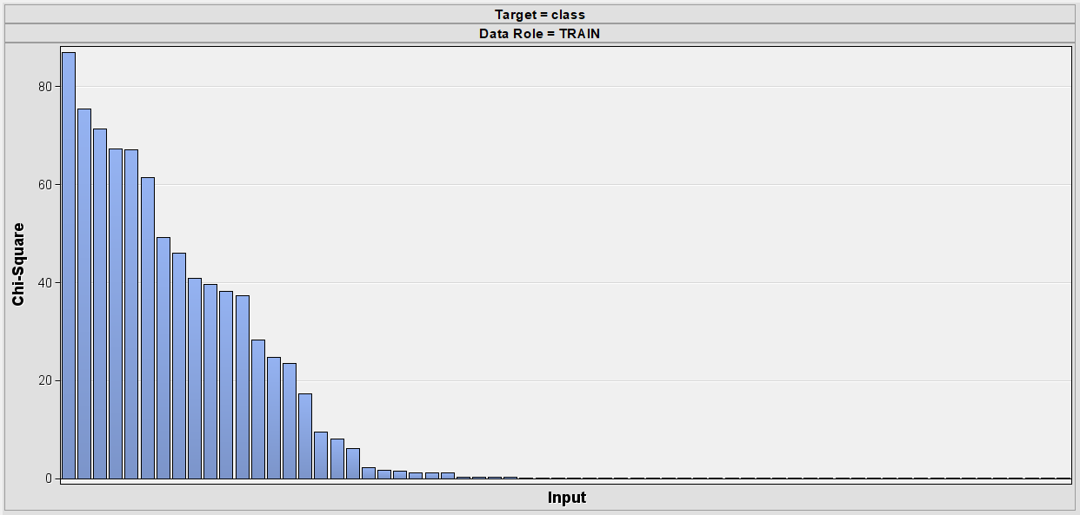

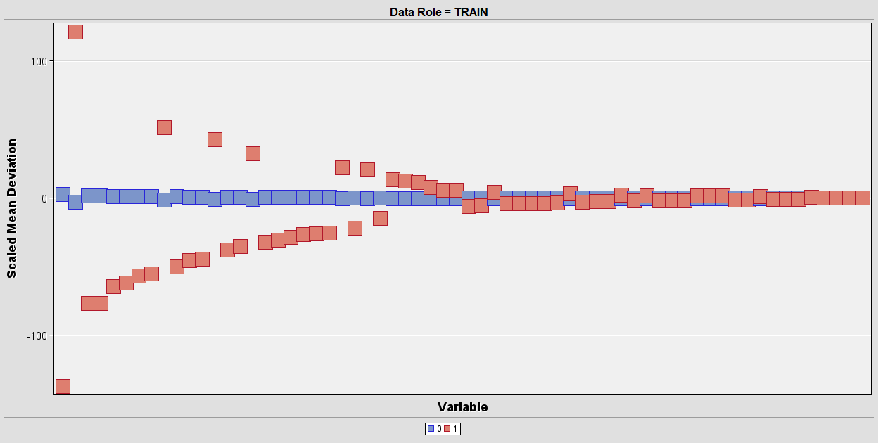
Exploratory Data Analysis (EDA)
StatsExplore Node
Chi-Square plot
The larger, the higher associate with bankruptcy variable.19 bins are larger than 5. 39 bins are smaller than 1
Input Variable by class
Some financial ratios can differentiate bankruptcy, while some shows very weak differentiate ability
The result are consistent with Chi-Square plot
Class Variable
Imbalanced dataset with 211 as Bankruptcy = 1,
9789 as Bankruptcy = 0
Overview
Exploratory Data Analysis
Data Preprocessing
Variable Selection
Model Selection
Thoughts

Slide 4
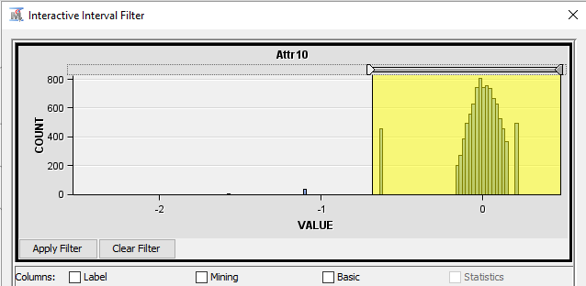

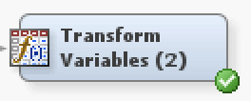
Data Preprocessing
Imbalance
Oversampling
SAS Code Node
Sample Node
Skewness
Filter Node
Transform Variables
Overview
Exploratory Data Analysis
Data Preprocessing
Variable Selection
Model Selection
Thoughts

Slide 5
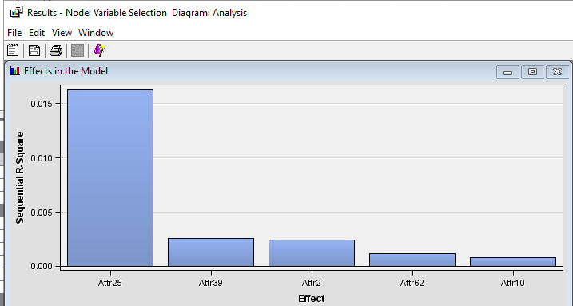
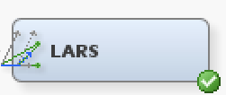
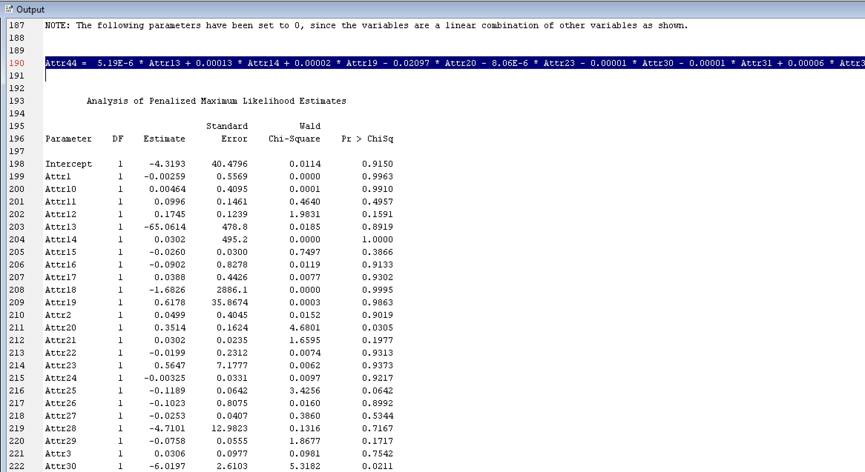
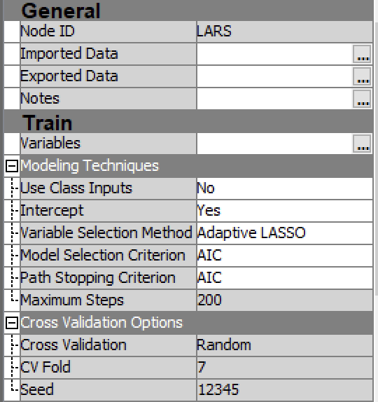
Variable Selection
Variable Selection Node
Only 5 variables were accepted
LARS Node
Remove highly correlated variables to reduce Multicolinearity
Attr44 can be expressed as a linear combination equation of the remaining variables.
Rejected Attr44
Overview
Exploratory Data Analysis
Data Preprocessing
Variable Selection
Model Selection
Thoughts

Slide 6
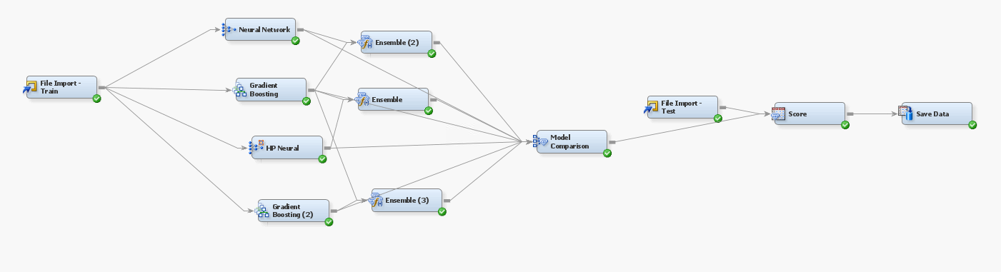
Model Comparison
Overview
Exploratory Data Analysis
Data Preprocessing
Variable Selection
Model Selection
Thoughts

Slide 7
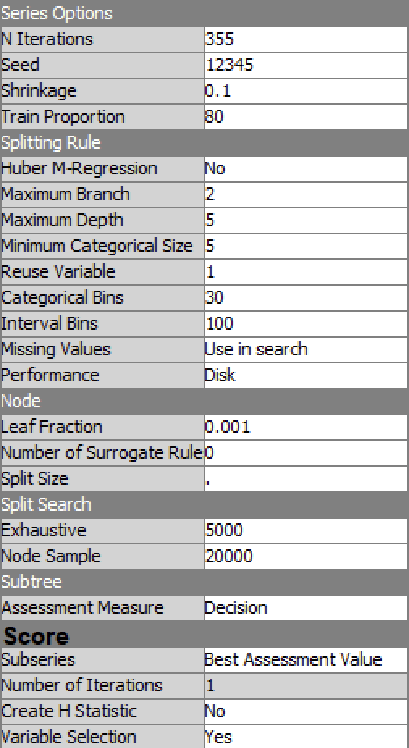
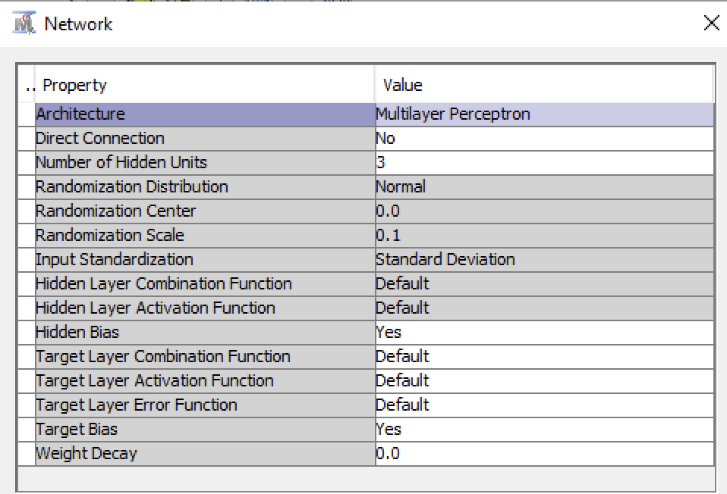
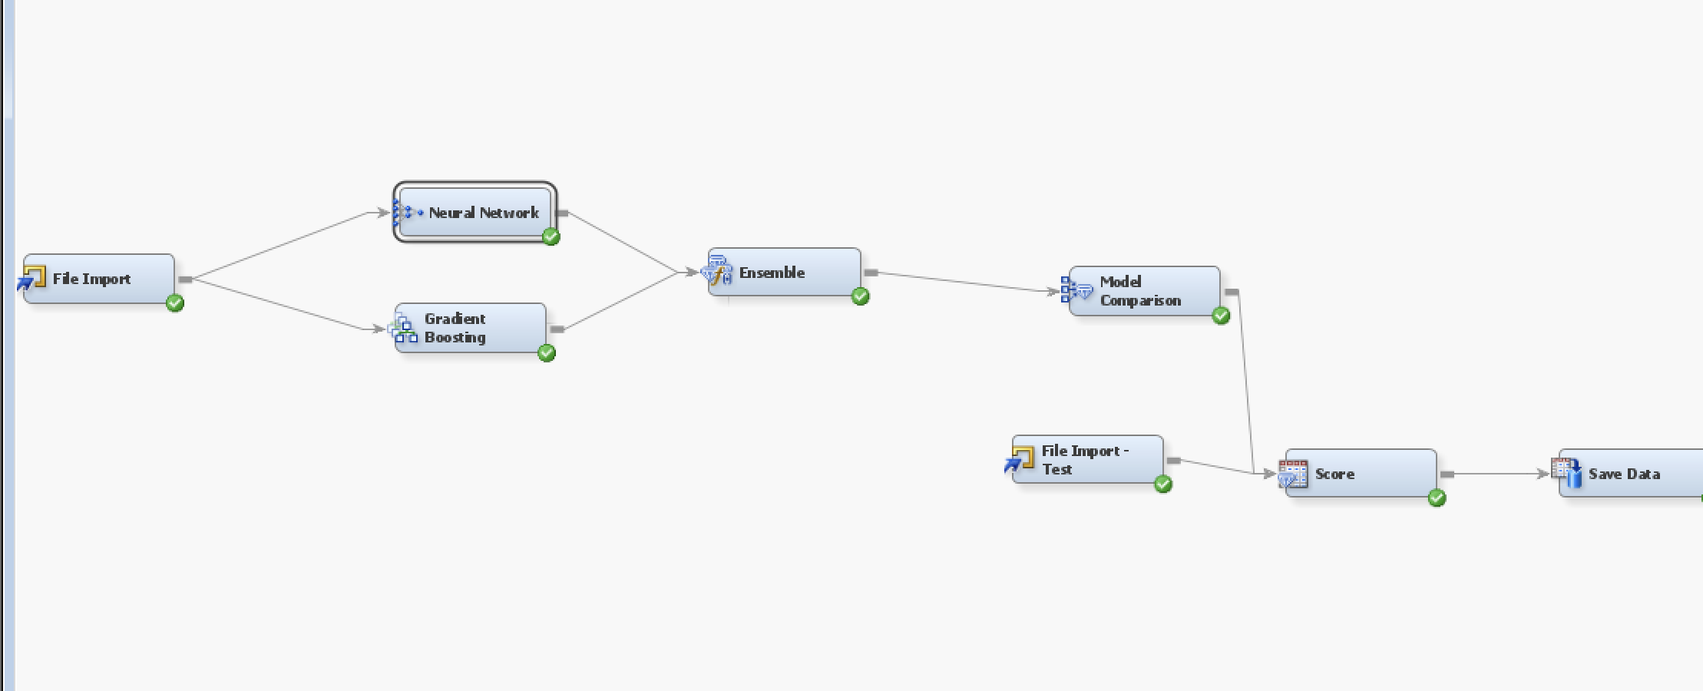
Model Selection
Data Partition Node
Tried 60/40, 70/30, 80/20, 100/0. 100/0 works the best -- May due to the imbalance
Gradient Boosting
Leaf Fraction:0.001
N- Iterations - 355
Shrinkage: 0.1
Maximum Depth: 5
Ensemble
Neural Network
Architecture: Multilayer Perception
N - Iterations - 999
Hidden Units: 3
Overview
Exploratory Data Analysis
Data Preprocessing
Variable Selection
Model Selection
Thoughts

Slide 8
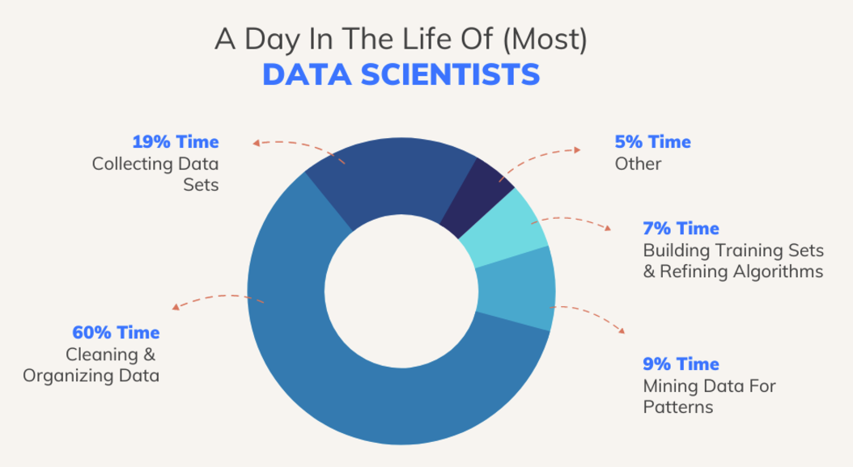
Thoughts and Lessons learned….
Be Patient, trial and error
Never give up, always strive to explore all possibilities
Even if we didn’t use any methods that we tried at the beginning in our final submission, we learned a lot from it!
Consider the Business background
In this project, we considered that the predictor variables are financial ratios, which can be highly correlated with each other and can be roughly divided by 5 groups. Though we didn’t use this feature in the final submission, we considered it’s important and might be useful in future practice
Know about the dataset
Before doing preprocessing, look at the dataset, otherwise, it might be futile efforts
Good way to detect outliers is visualizing it
Overview
Exploratory Data Analysis
Data Preprocessing
Variable Selection
Model Selection
Thoughts

